Slide 1

Programming and Data Structures
Debasis Samanta
Computer Science & Engineering
Indian Institute of Technology Kharagpur
Spring-2017

Slide 2
Lecture #10
Linked Lists

Slide 3
Today’s Discussion…
Introduction to linked list
Array versus linked list
Linked lists in C
Types of linked lists
Single linked list
Doubly linked list
Circular linked list

Slide 4
Introduction to Linked Lists

Slide 5
Linked List
A linked list is a data structure which allows to store data dynamically and manage data efficiently.
Typically, a linked list, in its simplest form looks like the following
header
A
B
C
NULL

Slide 6
Linked List
Few salient features
There is a pointer (called header) points the first element (also called node)
Successive nodes are connected by pointers.
Last element points to NULL.
It can grow or shrink in size during execution of a program.
It can be made just as long as required.
It does not waste memory space, consume exactly what it needs.

Slide 7
Arrays versus Linked Lists

Slide 8
Array: Contagious Storage

Slide 9
Array versus Linked Lists
In arrays
elements are stored in a contagious memory locations
Arrays are static data structure unless we use dynamic memory allocation
Arrays are suitable for
Inserting/deleting an element at the end.
Randomly accessing any element.
Searching the list for a particular value.

Slide 10
Linked List: Non-Contagious Storage
a
15
b
45
c
25
d
50
e
22
f
35
g
30
h
10
i
20
j
k
40

Slide 11
Array versus Linked Lists
In Linked lists
adjacency between any two elements are maintained by means of links or pointers
It is essentially a dynamic data structure
Linked lists are suitable for
Inserting an element at any position.
Deleting an element from any where.
Applications where sequential access is required.
In situations, where the number of elements cannot be predicted beforehand.

Slide 12
Linked Lists in C

Slide 13
Defining a Node of a Linked List
Each structure of the list is called a node, and consists of two fields:
Item (or) data
Address of the next item in the list (or) pointer to the next node in the list
How to define a node of a linked list?
struct node
{
int data; /* Data */
struct node *next; /* pointer*/
} ;
node
Data
next
Note:
Such structures which contain a member field pointing to the same structure type are called self-referential structures.

Slide 14
Types of Lists: Single Linked List
Depending on the way in which the links are used to maintain adjacency, several different types of linked lists are possible.
Single linked list (or simply linked list)
A head pointer addresses the first element of the list.
Each element points at a successor element.
The last element has a link value NULL.
head
A
B
C
NULL

Slide 15
Types of Lists: Double Linked List
Double linked list
Pointers exist between adjacent nodes in both directions.
The list can be traversed either forward or backward.
Usually two pointers are maintained to keep track of the list, head and tail.
head
tail
A
B
C

Slide 16
Defining a Node of a Double Linked List
Each node of doubly linked list (DLL) consists of three fields:
Item (or) Data
Pointer of the next node in DLL
Pointer of the previous node in DLL
node
Data
prev
next
How to define a node of a doubly linked list (DLL)?
struct node
{
int data;
struct node *next; // Pointer to next node in DLL
struct node *prev; // Pointer to previous node in DLL
};

Slide 17
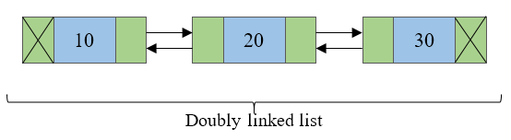
Double Linked List
Doubly linked list is a collection of nodes linked together in a sequential way.
Doubly linked list is almost similar to singly linked list except it contains two address or reference fields, where one of the address field contains reference of the next node and other contains reference of the previous node.
First and last node of a linked list contains a terminator generally a NULL value, that determines the start and end of the list.
Doubly linked list is sometimes also referred as bi-directional linked list since it allows traversal of nodes in both direction.
Since doubly linked list allows the traversal of nodes in both direction, we can keep track of both first and last nodes.

Slide 18
Double versus Single Linked List
Advantages over singly linked list
A DLL can be traversed in both forward and backward direction.
The delete operation in DLL is more efficient if pointer to the node to be deleted is given.
Disadvantages over singly linked list
Every node of DLL Require extra space for an previous pointer.
All operations require an extra pointer previous to be maintained.

Slide 19
Types of Lists: Circular Linked List
Circular linked list
The pointer from the last element in the list points back to the first element.
head
A
B
C

Slide 20
Circular Linked List
A circular linked list is basically a linear linked list that may be single- or double-linked.
The only difference is that there is no any NULL value terminating the list.
In fact in the list every node points to the next node and last node points to the first node, thus forming a circle. Since it forms a circle with no end to stop it is called as circular linked list.
In circular linked list there can be no starting or ending node, whole node can be traversed from any node.
In order to traverse the circular linked list, only once we need to traverse entire list until the starting node is not traversed again.
A circular linked list can be implemented using both singly linked list and doubly linked list.

Slide 21
Example 1: Creating a Single Linked List
Linked list to store and print roll number, name and age of 3 students.
#include <stdio.h>
struct stud
{
int roll;
char name[30];
int age;
struct stud *next;
};
main()
{
struct stud n1, n2, n3;
struct stud *p;
scanf (“%d %s %d”, &n1.roll, n1.name, &n1.age);
scanf (“%d %s %d”, &n2.roll,n2.name, &n2.age);
scanf (“%d %s %d”, &n3.roll,n3.name, &n3.age);

Slide 22
Example 1: Creating a Single Linked List
n1.next = &n2 ;
n2.next = &n3 ;
n3.next = NULL ;
/* Now traverse the list and print the elements */
p = &n1 ; /* point to 1st element */
while (p != NULL)
{
printf (“\n %d %s %d”, p->roll, p->name, p->age);
p = p->next;
}
}

Slide 23
Example 1: Illustration
The structure:
struct stud
{
int roll;
char name[30];
int age;
struct stud *next;
};
Also assume the list with three nodes n1, n2 and n3 for 3 students.
struct stud n1, n2, n3;

Slide 24
Example 1: Illustration
To create the links between nodes, it is written as:
n1.next = &n2 ;
n2.next = &n3 ;
n3.next = NULL ; /* No more nodes follow */
• Now the list looks like:
roll
name
age
next
NULL
n1
n2
n3

Slide 25
Example 2: Creating a Single Linked List
C-program to store 10 values on a linked list reading the data from keyboard.
#include <stdio.h>
#include <stdlib.h>
struct node {
int data; //Data part
struct node *next; //Address part
}*header;
void createList(int n); /* Functions to create a list*/
int main()
{
int n;
printf("Enter the total number of nodes: ");
scanf("%d", &n);
createList(n);
return 0;
}

Slide 26
Example 2: Creating a Single Linked List
void createList(int n)
{
struct node *newNode, *temp;
int data, i;
/* A node is created by allocating memory to a structure */
newNode = (struct node *)malloc(sizeof(struct node));
/* If unable to allocate memory for head node */
if(newNode == NULL)
{
printf("Unable to allocate memory.");
}
else
{
printf("Enter the data of node 1: ");
scanf("%d", &data);
newNode->data = data; //Links the data field with data
newNode->next = NULL; //Links the address field to NULL
header = newNode; //Header points to the first node
temp = newNode; //First node is the current node

Slide 27
Example 2: Creating a Single Linked List
for(i=2; i<= n; i++)
{
/* A newNode is created by allocating memory */
newNode = (struct node *)malloc(sizeof(struct node));
if(newNode == NULL)
{
printf("Unable to allocate memory.");
break;
}
else
{
printf("Enter the data of node %d: ", i);
scanf("%d", &data);
newNode->data = data; //Links the data field of newNode with data
newNode->next = NULL; //Links the address field of newNode with NULL
temp->next = newNode; //Links previous node i.e. temp to the newNode
temp = temp->next;
}
}
}
}

Slide 28
Example 2: Illustration
To start with, we have to create a node (the first node), and make header point to it.
newNode = (struct node *)malloc(sizeof(struct node));
newNode->data = data; //Links the data field with data
newNode->next = NULL; //Links the address field to NULL
header = newNode;
temp = newNode;
It creates a single node. For example, if the data entered is 100 then the list look like
header
100
NULL

Slide 29
Creating a single linked list
If we need n number of nodes in the linked list:
Allocate n newNodes, one by one.
Read in the data for the newNodes.
Modify the links of the newNodes so that the chain is formed.
newNode = (struct node *)malloc(sizeof(struct node));
newNode->data = data; //Links the data field of newNode with data
newNode->next = NULL; //Links the address field of newNode with NULL
temp->next = newNode; //Links previous node i.e. temp to the newNode
temp = temp->next;
It creates n number of nodes . For e.g. if the data entered is 200, 50, 30 then the list look like
head
100
200
50
30
NULL

Slide 30
Example 3: Creating a Single Linked List
C-program to copy an array to a single linked list.
#include <stdio.h>
#include <stdlib.h>
struct node {
int data; //Data part
struct node *next; //Address part
};
int main()
{
struct node *header, *newNode, *temp;
int data, i, n, a[100];
printf("Enter the total number of data: ");
scanf("%d", &n);
// Write code here to initialize the array a with n elements //
...

Slide 31
Example 2: Creating a Single Linked List
/* A node is created by allocating memory to a structure */
newNode = (struct node *)malloc(sizeof(struct node));
/* If unable to allocate memory for head node */
if(newNode == NULL)
{
printf("Unable to allocate memory.");
}
else
{
newNode->data = a[0]; //Links the data field with data
newNode->next = NULL; //Links the address field to NULL
header = newNode; //Header points to the first node
temp = header;

Slide 32
Example 2: Creating a Single Linked List
for(i = 1; i <= n; i++)
{
/* A newNode is created by allocating memory */
newNode = (struct node *)malloc(sizeof(struct node));
if(newNode == NULL)
{
printf("Unable to allocate memory.");
break;
}
else
{
newNode->data = a[i]; //Links the data field of newNode with a[i]
newNode->next = NULL; //Links the address field of newNode with NULL
temp->next = newNode; //Links previous node i.e. temp to the newNode
temp = temp->next;
}
}
}
}

Slide 33
Operations on Linked Lists

Slide 34
Operations on single linked list
Traversing a list
Printing, finding minimum, etc.
Insertion of a node into a list
At front, end and anywhere, etc.
Deletion of a node from a list
At front, end and anywhere, etc.
Comparing two linked lists
Similarity, intersection, etc.
Merging two linked lists into a larger list
Union, concatenation, etc.
Ordering a list
Reversing, sorting, etc.

Slide 35
Traversing a Linked List

Slide 36
Single Linked List: Traversing
Once the linked list has been constructed and header points to the first node of the list,
Follow the pointers.
Display the contents of the nodes as they are traversed.
Stop when the next pointer points to NULL.
The function traverseList(struct Node *) is given in the next slide. This function to be called from main() function as:
int main()
{
// Assume header, the pointer to the linked list is given as an input
printf("\n Data in the list \n");
traverseList(header);
return 0;
}

Slide 37
Single linked list: Traversing
void traverseList(struct Node *header)
{
struct node *temp;
/* If the list is empty i.e. head = NULL */
if(header == NULL)
{
printf("List is empty.");
}
else
{
temp = header;
while(temp != NULL)
{
printf("Data = %d\n", temp->data); //Prints the data of current node
temp = temp->next; //Advances the position of current node
}
}
}

Slide 38
Insertion in a Linked List

Slide 39
Single Linked List: Insertion
Insertion steps:
Create a new node
Start from the header node
Manage links to
Insert at front
Insert at end
Insert at any position

Slide 40
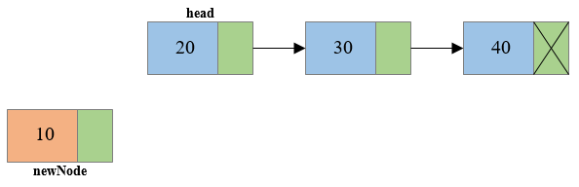
Insertion at Front
Steps to insert node at the beginning of singly linked list
Step 1: Create a new node.

Slide 41
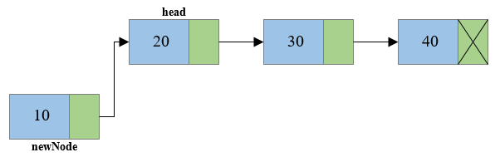
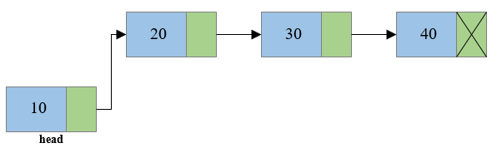
Insertion at Front
Step 2: Link the newly created node with the head node, i.e. the newNode will now point to head node.
Step 3: Make the new node as the head node, i.e. now head node will point to newNode.

Slide 42
Insertion at front
/*Create a new node and insert at the beginning of the linked list.*/
void insertNodeAtBeginning(int data)
{
struct node *newNode;
newNode = (struct node*)malloc(sizeof(struct node));
if(newNode == NULL)
{
printf("Unable to allocate memory.");
}
else
{
newNode->data = data; //Links the data part
newNode->next = head; //Links the address part
head = newNode; //Makes newNode as first node
printf("DATA INSERTED SUCCESSFULLY\n");
}
}

Slide 43
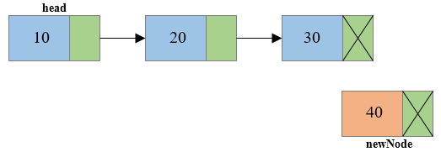
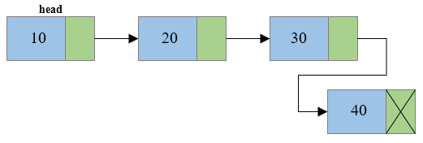
Single Linked List: Insertion at End
Steps to insert node at the end of Singly linked list
Step 1: Create a new node and make sure that the address part of the new node points to NULL. i.e. newNode->next=NULL
Step 2: Traverse to the last node of the linked list and connect the last node of the list with the new node, i.e. last node will now point to new node. (lastNode->next = newNode).

Slide 44
Insertion at End
/* Create a new node and insert at the end of the linked list. */
void insertNodeAtEnd(int data)
{
struct node *newNode, *temp;
newNode = (struct node*)malloc(sizeof(struct node));
if(newNode == NULL)
{
printf("Unable to allocate memory.");
}
else
{
newNode->data = data; //Links the data part
newNode->next = NULL;
temp = head;
while(temp->next != NULL) //Traverse to the last node
temp = temp->next;
temp->next = newNode; //Links the address part
printf("DATA INSERTED SUCCESSFULLY\n");
}
}

Slide 45
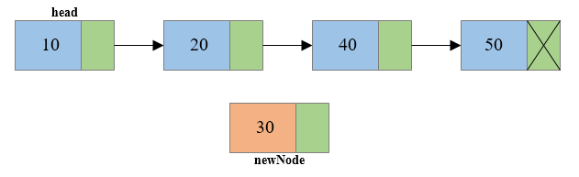
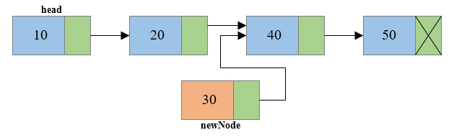
Single Linked List: Insertion at any Position
Steps to insert node at any position of Singly Linked List
Step 1: Create a new node.
Step 2: Traverse to the n-1th position of the linked list and connect the new node with the n+1th node. (newNode->next = temp->next) where temp is the n-1th node.

Slide 46
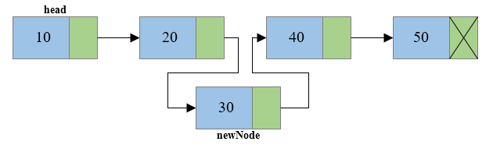
Single Linked List: Insertion at any position
Step 3: Now at last connect the n-1th node with the new node i.e. the n-1th node will now point to new node. (temp->next = newNode) where temp is the n-1th node.

Slide 47
Insertion at any Position
/* Create a new node and insert at middle of the linked list.*/
void insertNodeAtMiddle(int data, int position)
{
int i;
struct node *newNode, *temp;
newNode = (struct node*)malloc(sizeof(struct node));
if(newNode == NULL)
{
printf("Unable to allocate memory.");
}
else
{
newNode->data = data; //Links the data part
newNode->next = NULL;
temp = head;

Slide 48
Insertion at any Position
for(i=2; i<=position-1; i++) /* Traverse to the n-1 position */
{
temp = temp->next;
if(temp == NULL)
break;
}
if(temp != NULL)
{
/* Links the address part of new node */
newNode->next = temp->next;
/* Links the address part of n-1 node */
temp->next = newNode;
printf("DATA INSERTED SUCCESSFULLY\n");
}
else
{
printf("UNABLE TO INSERT DATA AT THE GIVEN POSITION\n");
}
}
}

Slide 49
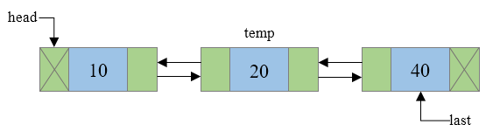
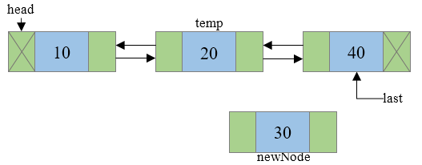
Double Linked List: Insertion at any Position
Steps to insert a new node at n^{th} position in a Doubly linked list.
Step 1: Traverse to N-1 node in the list, where N is the position to insert. Say temp now points to N-1th node.
Step 2: Create a newNode that is to be inserted and assign some data to its data field.

Slide 50
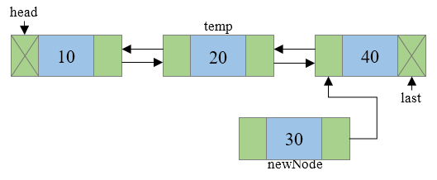
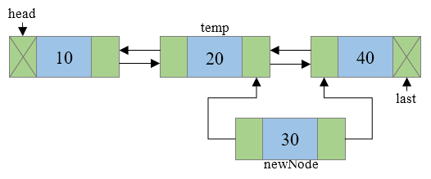
Doubly Linked List: Insertion at any Position
Step 3: Connect the next address field of newNode with the node pointed by next address field of temp node.
Step 4: Connect the previous address field of newNode with the temp node.

Slide 51
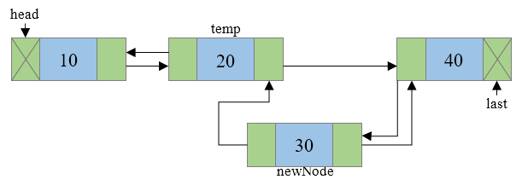
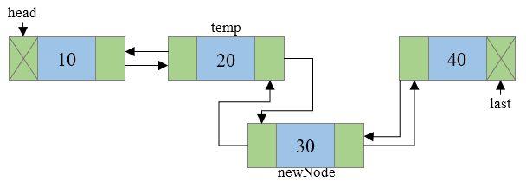
Doubly Linked List: Insertion at any Position
Step 5: Check if temp.next is not NULL then, connect the previous address field of node pointed by temp.next to newNode.
Step 6: Connect the next address field of temp node to newNode.

Slide 52
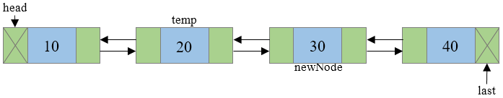
Doubly Linked List: Insertion at any Position
Step 7: Final doubly linked list looks like

Slide 53
Doubly Linked List: Insertion at any Position
#include <stdio.h>
#include <stdlib.h>
struct node { /* Basic structure of Node */
int data;
struct node * prev;
struct node * next;
}*head, *last;
int main()
{
int n, data;
head = NULL;
last = NULL;
printf("Enter the total number of nodes in list: ");
scanf("%d", &n);
createList(n); // function to create double linked list
displayList(); // function to display the list
printf("Enter the position and data to insert new node: ");
scanf("%d %d", &n, &data);
insert_position(data, n); // function to insert node at any position
displayList();
return 0;
}

Slide 54
Doubly Linked List: Insertion at any Position
void createList(int n)
{
int i, data;
struct node *newNode;
if(n >= 1){ /* Creates and links the head node */
head = (struct node *)malloc(sizeof(struct node));
printf("Enter data of 1 node: ");
scanf("%d", &data);
head->data = data;
head->prev = NULL;
head->next = NULL;
last = head;
for(i=2; i<=n; i++){ /* Creates and links rest of the n-1 nodes */
newNode = (struct node *)malloc(sizeof(struct node));
printf("Enter data of %d node: ", i);
scanf("%d", &data);
newNode->data = data;
newNode->prev = last; //Links new node with the previous node
newNode->next = NULL;
last->next = newNode; //Links previous node with the new node
last = newNode; //Makes new node as last/previous node
}
printf("\nDOUBLY LINKED LIST CREATED SUCCESSFULLY\n");
}
}

Slide 55
Doubly Linked List: Insertion at any Position
void insert_position(int data, int position)
{
struct node * newNode, *temp;
if(head == NULL){
printf("Error, List is empty!\n");
}
else{
temp = head;
if(temp!=NULL){
newNode = (struct node *)malloc(sizeof(struct node));
newNode->data = data;
newNode->next = temp->next; //Connects new node with n+1th node
newNode->prev = temp; //Connects new node with n-1th node
if(temp->next != NULL)
{
temp->next->prev = newNode; /* Connects n+1th node with new node */
}
temp->next = newNode; /* Connects n-1th node with new node */
printf("NODE INSERTED SUCCESSFULLY AT %d POSITION\n", position);
}
else{
printf("Error, Invalid position\n");
}
}
}

Slide 56
Doubly Linked List: Insertion at any Position
void displayList()
{
struct node * temp;
int n = 1;
if(head == NULL)
{
printf("List is empty.\n");
}
else
{
temp = head;
printf("DATA IN THE LIST:\n");
while(temp != NULL)
{
printf("DATA of %d node = %d\n", n, temp->data);
n++;
/* Moves the current pointer to next node */
temp = temp->next;
}
}
}

Slide 57
Few Exercises to Try Out
For doubly linked list write a function to:
Insert a node at front of the list and at end of the list.
insert_front(data);
insert_end(data);
Sort the DLL in ascending order.
Count the number of nodes in the given DLL.

Slide 58
Deletion from a Linked List

Slide 59
Single Linked List: Deletion
Deletion steps
Start from the header node
Manage links to
Delete at front
Delete at end
Delete at any position
freeingup the node as free space.

Slide 60
Free Memory after Deletion
Do not forget to free() memory location dynamically allocated for a node after deletion of that node.
It is the programmer’s responsibility to free that memory block.
Failure to do so may create a dangling pointer – a memory, that is not used either by the programmer or by the system.
The content of a free memory is not erased until it is overwritten.

Slide 61
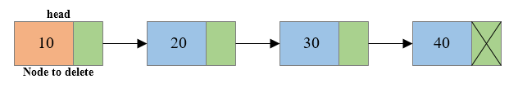
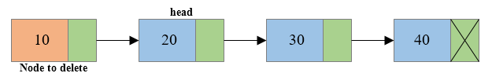
Single Linked List: Deletion at Front
Steps to delete first node of Singly Linked List
Step 1: Copy the address of first node i.e. head node to some temp variable say toDelete.
Step 2: Move the head to the second node of the linked list (head = head->next).

Slide 62
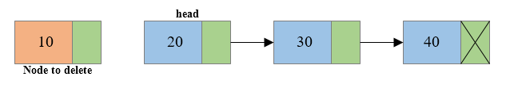

Single linked list: Deletion at front
Step 3: Disconnect the connection of first node to second node.
Step 4: Free the memory occupied by the first node.

Slide 63
Deletion at Front
/* Delete the first node of the linked list */
void deleteFirstNode()
{
struct node *toDelete;
if(head == NULL)
{
printf("List is already empty.");
}
else
{
toDelete = head;
head = head->next;
printf("\nData deleted = %d\n", toDelete->data);
/* Clears the memory occupied by first node*/
free(toDelete);
printf("SUCCESSFULLY DELETED FIRST NODE FROM LIST\n");
}
}

Slide 64
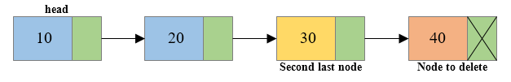
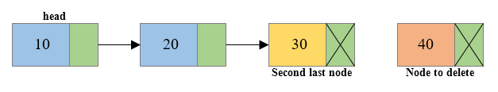
Single linked list: Deletion at End
Steps to delete last node of a Singly Linked List
Step 1: Traverse to the last node of the linked list keeping track of the second last node in some temp variable say secondLastNode.
Step 2: If the last node is the head node then make the head node as NULL else disconnect the second last node with the last node i.e. secondLastNode->next = NULL

Slide 65
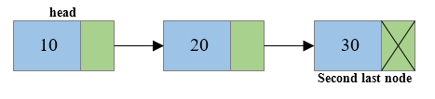
Single linked list: Deletion at End
Step 3: Free the memory occupied by the last node.

Slide 66
Deletion at End
/* Delete the last node of the linked list */
void deleteLastNode()
{
struct node *toDelete, *secondLastNode;
toDelete = head;
secondLastNode = head;
while(toDelete->next != NULL) /* Traverse to the last node of the list*/
{
secondLastNode = toDelete;
toDelete = toDelete->next;
}
if(toDelete == head)
{
head = NULL;
}
else
{
/* Disconnects the link of second last node with last node */
secondLastNode->next = NULL;
}
/* Delete the last node */
free(toDelete);
}

Slide 67
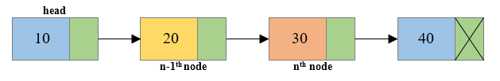
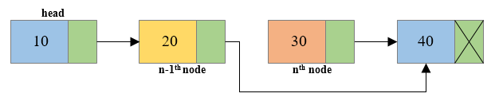
Single Linked List: Deletion at any Position
Steps to delete a node at any position of Singly Linked List
Step 1: Traverse to the n^{th} node of the singly linked list and also keep reference of n-1th node in some temp variable say prevNode.
Step 2: Reconnect n-1th node with the n+1th node i.e. prevNode->next = toDelete->next (Where prevNode is n-1th node and toDelete node is the n^{th} node and toDelete->next is the n+1th node).

Slide 68
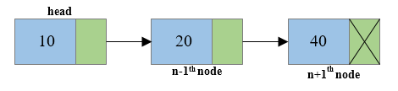
Single Linked List: Deletion at any Position
Step 3: Free the memory occupied by the n^{th} node i.e. toDelete node.

Slide 69
Deletion at any Position
/* Delete the node at any given position of the linked list */
void deleteMiddleNode(int position)
{
int i;
struct node *toDelete, *prevNode;
if(head == NULL)
{
printf("List is already empty.");
}
else
{
toDelete = head;
prevNode = head;
for(i=2; i<=position; i++)
{
prevNode = toDelete;
toDelete = toDelete->next;
if(toDelete == NULL)
break;
}

Slide 70
Deletion at any Position
if(toDelete != NULL)
{
if(toDelete == head)
head = head->next;
prevNode->next = toDelete->next;
toDelete->next = NULL;
/* Deletes the n node */
free(toDelete);
printf("SUCCESSFULLY DELETED NODE FROM MIDDLE OF LIST\n");
}
else
{
printf("Invalid position unable to delete.");
}
}
}

Slide 71
Comparing Two Linked Lists

Slide 72
Single Linked List: Comparing two Lists
Comparing two linked list includes
Identifying whether the given two linked list are identical.
Two Linked Lists are identical when they have same data and arrangement of data is also same.
Checking whether the lists have same values when the arrangement is not same.

Slide 73
Comparing two Linked Lists
/* Return true if linked lists a and b are identical, otherwise false */
bool areIdentical(struct node *a, struct node *b)
{
while (a != NULL && b != NULL)
{
if (a->data != b->data)
return false;
/* If we reach here, then a and b are not NULL and their data is same, so move to next nodes in both lists */
a = a->next;
b = b->next;
}
//If linked lists are identical, then 'a' and 'b' must be NULL at this point.
return (a == NULL && b == NULL);
}
int main()
{
struct node *a, *b;
a = createList(5); // e.g: a: 5->4->3->2->1
b = createList(5); // e.g: b: 5->4->3->2->1
areIdentical(a, b)? printf("Identical"): printf("Not identical");
return 0;
}

Slide 74
Few Exercises to Try Out
Write a function to:
Concatenate or merge two given list into one big list.
node *concatenate(node *a, node *b);
Compare two given list with same data but different arrangement.
e.g: a: 5->4->3->2->1
b: 1->2->3->4->5
Count the number of nodes in the given list using iterative method and recursive method.

Slide 75
Ordering Linked List

Slide 76
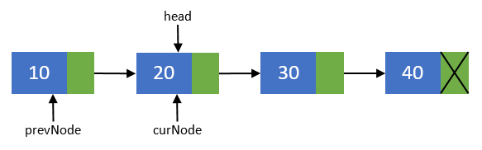
Single Linked List: Reversing
Reversing a list can be performed in two ways:
Iterative method
Recursive method
Steps to reverse a Singly Linked List using Iterative method
Step 1: Create two more pointers other than head namely prevNode and curNode that will hold the reference of previous node and current node respectively.
Make sure that prevNode points to first node i.e. prevNode = head.
head should now point to its next node i.e. head = head->next.
curNode should also points to the second node i.e. curNode = head.

Slide 77
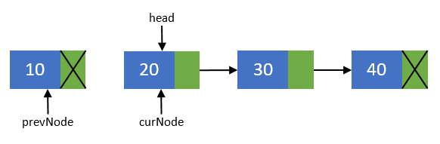
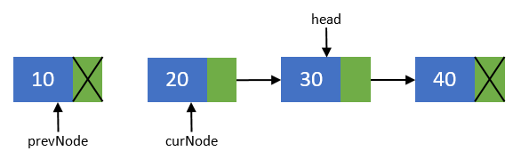
Reversing a List
Step 2: Now, disconnect the first node from others. We will make sure that it points to none. As this node is going to be our last node. Perform operation prevNode->next = NULL.
Step 3: Move the head node to its next node i.e. head = head->next.

Slide 78
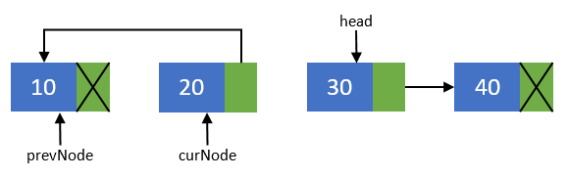
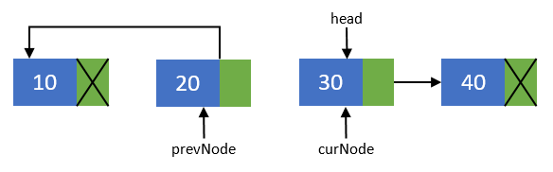
Reversing a List
Step 4: Now, re-connect the current node to its previous node
i.e. curNode->next = prevNode;
Step 5: Point the previous node to current node and current node to head node. Means they should now point to prevNode = curNode; and curNode = head.

Slide 79
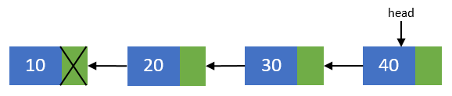
Reversing a List
Step 6: Repeat steps 3-5 till head pointer becomes NULL.
Step 7: Now, after all nodes has been re-connected in the reverse order. Make the last node as the first node. Means the head pointer should point to prevNode pointer.
Perform head = prevNode; And finally you end up with a reversed linked list of its original.

Slide 80
Reversing a List: Iterative Method
void reverseList()
{
struct node *prevNode, *curNode;
if(head != NULL)
{
prevNode = head;
curNode = head->next;
head = head->next;
prevNode->next = NULL; //Makes the first node as last node
while(head != NULL)
{
head = head->next;
curNode->next = prevNode;
prevNode = curNode;
curNode = head;
}
head = prevNode; //Makes the last node as head
printf("SUCCESSFULLY REVERSED LIST\n");
}
}

Slide 81
Reversing a List: Recursive Method
/* Function to reverse the linked list */
void Recursive_Reverse(struct node* head)
{
if (head == NULL) // boundary condition to stop recursion
return;
Recursive_Reverse(head->next); // print the list after head node
printf("%d ", head->data); // After everything else is printed, print head
}
/* It should be called from the main() function as */
int main()
{
int n = 10;
createList(n); // creates 10 nodes in the linked list
Recursive_Reverse(head);
return 0;
}

Slide 82
Single Linked List: Sorting
The linked list can be ordered using any of the following sorting algorithms:
Insertion sort
Selection sort
Merge sort
Quick sort
Bubble sort, etc.
Here, we discuss insertion sort for ordering linked list.

Slide 83
Sorting a List using Insertion Sort
// function to sort a singly linked list using insertion sort
void insertionSort(struct node **head_ref)
{
// Initialize sorted linked list
struct node *sorted = NULL;
// Traverse the given linked list and insert every node to be sorted
struct node *current = *head_ref;
while (current != NULL)
{
struct node *next = current->next;
// insert current in sorted linked list
sortedInsert(&sorted, current);
current = next; // Update current
}
// Update head_ref to point to sorted linked list
*head_ref = sorted;
}

Slide 84
Sorting a List using Insertion Sort
/* function to insert a new_node in a list.*/
void sortedInsert(struct node** head_ref, struct node* new_node)
{
struct node* current;
/* Special case for the head end */
if (*head_ref == NULL || (*head_ref)->data >= new_node->data)
{
new_node->next = *head_ref;
*head_ref = new_node;
}
else
{
/* Locate the node before the point of insertion */
current = *head_ref;
while (current->next!=NULL && current->next->data < new_node->data)
{
current = current->next;
}
new_node->next = current->next;
current->next = new_node;
}
}

Slide 85
Sorting a List using Insertion Sort
int main()
{
int n=5;
createList(n);
insertionSort(&head);
printf("\nData after sorting the list \n");
displayList();
return 0;
}
Output:
Enter the data of node 1: 6
Enter the data of node 2: 88
Enter the data of node 3: 42
Enter the data of node 4: 21
Enter the data of node 5: 1
SINGLY LINKED LIST CREATED SUCCESSFULLY
Data after sorting the list
Data = 1
Data = 6
Data = 21
Data = 42
Data = 88

Slide 86

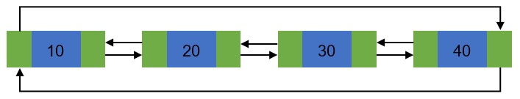
Circular linked list:
Basic structure of singly circular linked list:
Doubly circular linked list:

Slide 87
Circular linked list:
Advantages of a Circular linked list
Entire list can be traversed from any node.
Circular lists are the required data structure when we want a list to be accessed in a circle or loop.
Despite of being singly circular linked list we can easily traverse to its previous node, which is not possible in singly linked list.
Disadvantages of Circular linked list
Circular list are complex as compared to singly linked lists.
Reversing of circular list is a complex as compared to singly or doubly lists.
If not traversed carefully, then we could end up in an infinite loop.
Like singly and doubly lists circular linked lists also doesn’t supports direct accessing of elements.

Slide 88
Operations on circular linked list
Creation of list
Traversal of list
Insertion of node
At the beginning of list
At any position in the list
Deletion of node
Deletion of first node
Deletion of node from middle of the list
Deletion of last node
Counting total number of nodes
Reversing of list

Slide 89
Creation and Traversal of a Circular List
#include <stdio.h>
#include <stdlib.h>
/* Basic structure of Node */
struct node {
int data;
struct node * next;
}*head;
int main()
{
int n, data;
head = NULL;
printf("Enter the total number of nodes in list: ");
scanf("%d", &n);
createList(n); // function to create circular linked list
displayList(); // function to display the list
return 0;
}

Slide 90
Circular Linked List: Creation of List
void createList(int n)
{
int i, data;
struct node *prevNode, *newNode;
if(n >= 1){ /* Creates and links the head node */
head = (struct node *)malloc(sizeof(struct node));
printf("Enter data of 1 node: ");
scanf("%d", &data);
head->data = data;
head->next = NULL;
prevNode = head;
for(i=2; i<=n; i++){ /* Creates and links rest of the n-1 nodes */
newNode = (struct node *)malloc(sizeof(struct node));
printf("Enter data of %d node: ", i);
scanf("%d", &data);
newNode->data = data;
newNode->next = NULL;
prevNode->next = newNode; //Links the previous node with newly created node
prevNode = newNode; //Moves the previous node ahead
}
prevNode->next = head; //Links the last node with first node
printf("\nCIRCULAR LINKED LIST CREATED SUCCESSFULLY\n");
}
}

Slide 91
Circular Linked List: Traversal of List
void displayList()
{
struct node *current;
int n = 1;
if(head == NULL)
{
printf("List is empty.\n");
}
else
{
current = head;
printf("DATA IN THE LIST:\n");
do {
printf("Data %d = %d\n", n, current->data);
current = current->next;
n++;
}while(current != head);
}
}

Slide 92
Few Exercises to Try Out
For circular linked list write a function to:
Insert a node at any position of the list and delete from the beginning of the list.
insert_position(data,position);
delete_front();
Reverse the given circular linked link.

Slide 93

Any question?
You may post your question(s) at the “Discussion Forum” maintained in the course Web page.

Slide 94
Problems to Ponder…
Will be added shortly….

Slide 95
Problems for Practice…
You can check the Moodle course management system for a set of problems for your own practice.
Login to the Moodle system at http://cse.iitkgp.ac.in/
Select “PDS Spring-2017 (Theory) in the link “My Courses”
Go to Topic 10: Practice Sheet #10 : Linked Lists
Solutions to the problems in Practice Sheet #06 will be uploaded in due time.

Slide 96
If you try to solve problems yourself, then you will learn many things automatically.
Spend few minutes and then enjoy the study.

